Slide 1
MAKING BOUNDING BOX ON AN IMAGE USING DATA FILE
Prepared by:
Shruti mary mathew

Slide 2
OpenCV
OpenCV is a library of programming functions mainly helpful in computer vision.
It provides various functions. In this program the functions used are cv2.imread(), cv2.Rectangle(), cv2.imshow(), cv2.imwrite(), cv2.waitKey(), cv2.destroyAllWindow().
cv2.imread(path, flag)
cv2.rectangle(image, start_point, end_point, color, thickness)
cv2.imshow(window_name, image)
cv2.imwrite(filename, image)
cv2.waitKey(0)- It will display the window infinitely until any keypress
Ref: https://opencv.org/

Slide 3
xml.etree.ElementTree
It implements simple API for creating and parsing xml file.
It is represented like a tree.
ET has 2 classes- ElementTree represents the whole document while Element represents single node in tree.
Ref: https://docs.python.org/3/library/xml.etree.elementtree.html#module-xml.etree.ElementTree

Slide 4
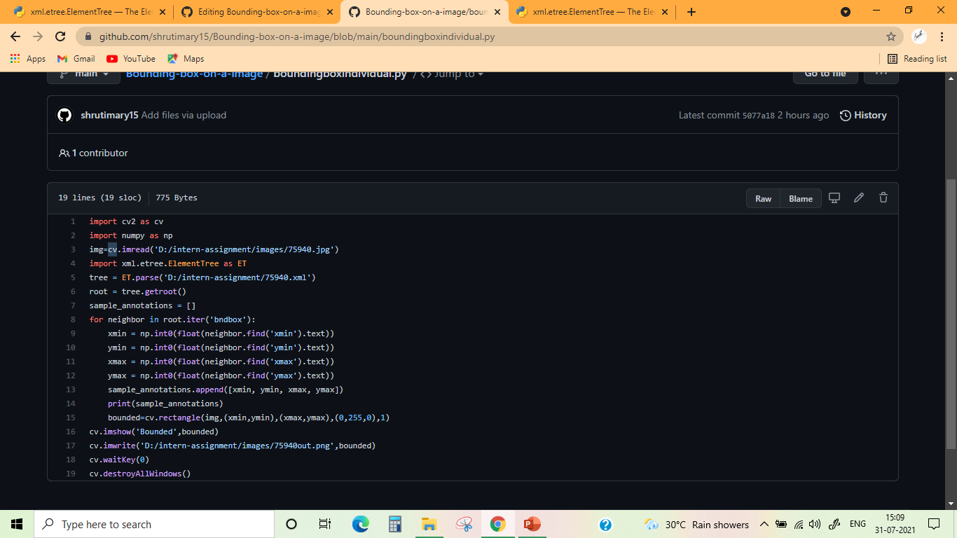
For importing and reading data from file-

Slide 5
For extracting the value of xmin, ymin, xmax and ymax-
Since the values given were a float value. It needs to be converted to int type before giving it to cv.Rectangle().

Slide 6
For drawing the rectangle-

Slide 7
Finally for saving the output as image file-

